Slide 1
Welcome and Welcome Back!
SWE UCR (swe.ucr@gmail.com)
October 1, 2013
1st General Meeting – Fall Quarter

Slide 2

Ice Breaker Time!

Slide 3
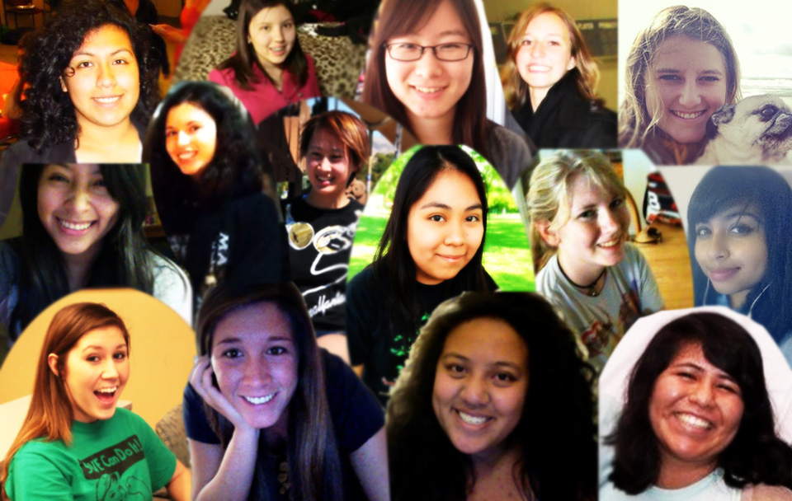
The Ladies of SWE

Slide 4

What is SWE?
The mission of the Student Section is to:
Develop programs to enable our members to improve their leadership, time management, communication and problem solving skills
Encourage girls and women to study engineering
Provide women with a sense of
belonging in the College, the
University, the community and in the
field of engineering
Demonstrate the value of diversity
and teamwork
Promote the engineering profession as
a positive force in improving the
quality of life

Slide 5



Upcoming Events
Nuts & Bolts Mentorship Program
SWE 13 National Conference
Baltimore, Maryland
Committees!
Bourns Engineering Day
Evening With Industry
Sports Team Fall Quarter
Volleyball

Slide 6
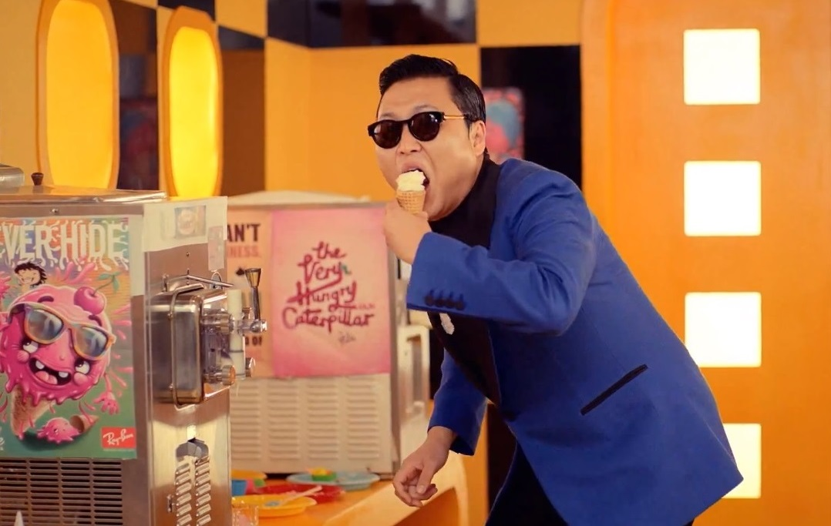
ICE CREAM, ICE CREAM!

Slide 7
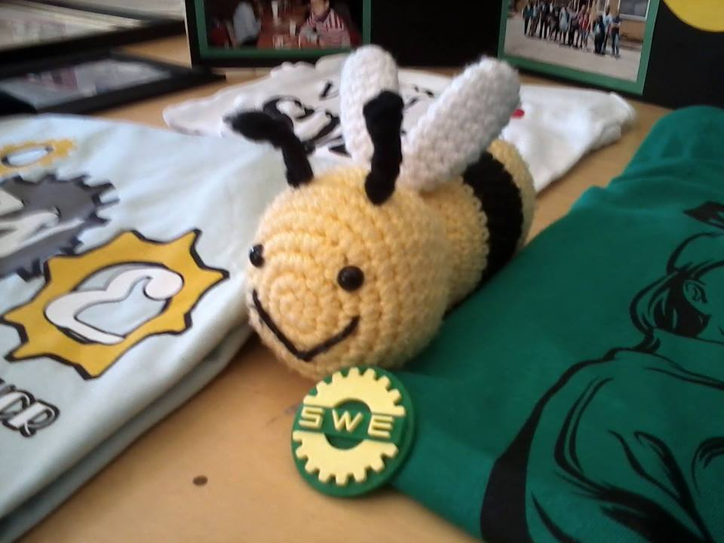
THANK YOU FOR COMING!
Our next general meeting is October 15th in WCH 205/206 at 7PM
We hope to see you all there again!

